Slide 1
Finance Report
2023 Results
2024 and Beyond
Summary

Slide 2
Finance Report – 2023 Results
General & Hall Funds
Income £240,617 vs £213,490 (231,982)
Expenditure £224,985 vs £229,115 (221,901)
Surplus £12,339 (2.4 weeks)
Other Income
Our ‘Reserves’ £13,000
External Support £ 6,500
£2,500 Multiply
£2,000 Young People/Community Events
£2,000 Fuel Support (from Diocese)
Also £9,500 SA Outreach / Building Fund
Reserves £93,400 (unchanged)

Slide 3
Finance Report – 2023 and Beyond…
Specific Funds (Restricted)
Expenditure
Income
c) Reserves
e) Sustainable

Slide 4
Finance Report – Income 2018 to 2023

Slide 5
Finance Report – Expenditure 2018 to 2023

Slide 6
Finance Report – 2024 and beyond
Regular Giving – steady, not matching inflation, needs a marked increase over the next few years
Securing income - from new groups and / or other sources will help
Expenditure – costs more stable, real living wage for 2025 will be lower. Energy still a ?
Balancing support - reserves / long term financial security vs. sustaining our mission to enable growth

Slide 7
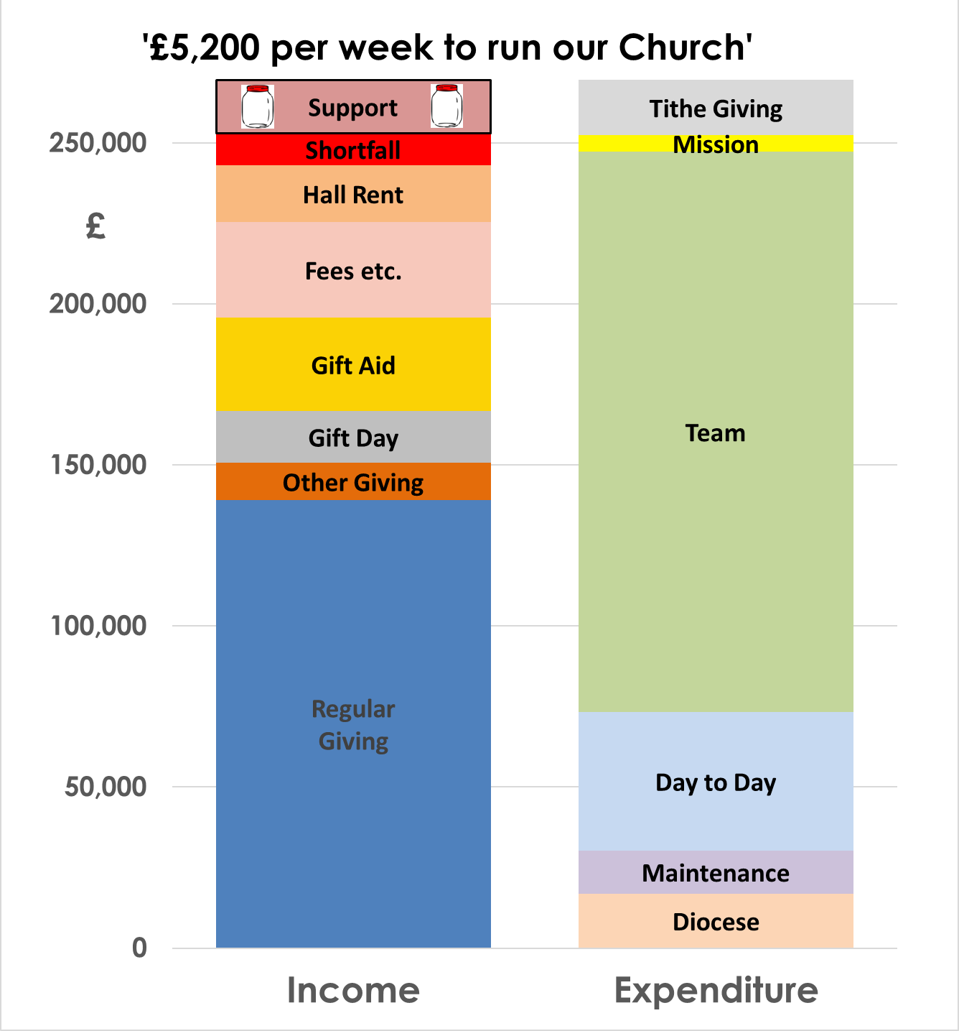
Finance Report – 2024 Budget
Our Challenges
Increase income
by 6%
Reduce ‘Support’ from our
Reserves
Build up our Regular Giver Numbers
We matched Living Wage increase-10%
Met increased Energy Costs

Slide 8
Finance Report – Summary
We are blessed with generous giving
We need do some ‘special’ things to grow our income to enable us to sustain our Mission
The effect of high inflation has resulted in a £20,000 gap in our finances
Maintain our fundraising for the Outreach project
We are in a good overall position
We can maintain our mission for a couple of years
Capture some extra income
Grow giving

